Slide 1
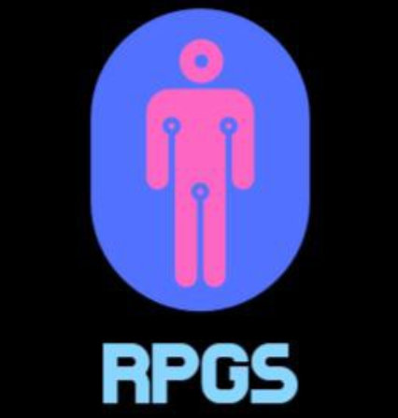
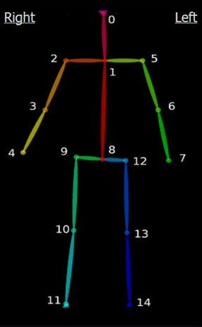
REALSENSE PHYSIOTHERAPY GUIDANCE SYSTEM ESP3902 GROUP 3 CHENGHUI, nabilah, WEIPIN

Slide 2
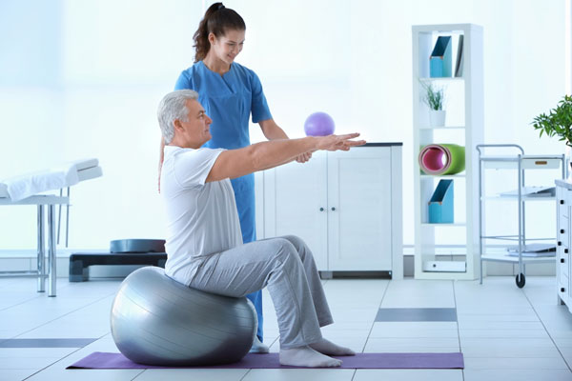
MOTIVATION FOR PROJECT
74% of YLDs* in the world is linked to health conditions for which rehabilitation is beneficial
Incorrectly attempting these exercises could lead to lack of progress or even injury
*years lived with disability (YLD): number of years spent in states of less than full health
Image source: https://www.edtreatmentplan.com/wp-content/uploads/2019/04/physiotherapy.jpg

Slide 3
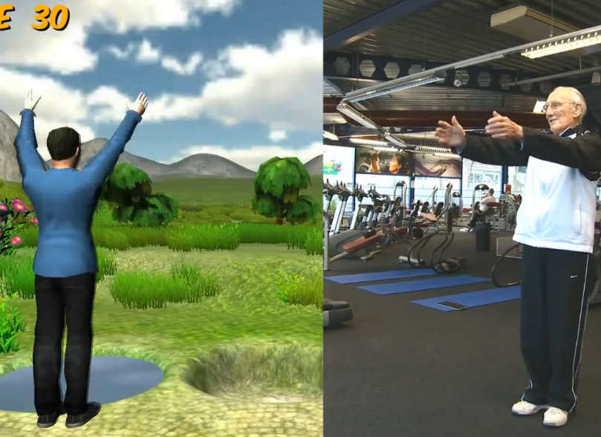
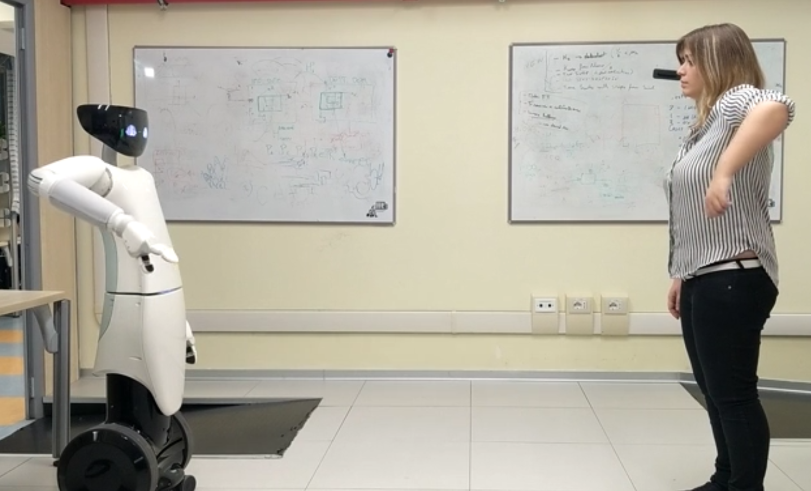
CURRENT WORKS in gait analysis
1. Physical therapy using a Kinect sensor rehabilitation
2. Assistive-rehab
Image source: https://www.youtube.com/watch?v=O18JUKk0kak&t=25s
Image source:https://robotology.github.io/assistive-rehab/doc/mkdocs/site/

Slide 4
Limitations of current works
1.
No automatic correction to incorrect posture
Relies on physiotherapist to be present
Kinect has been discontinued as of 2017.
2.
Not home friendly.
Potentially expensive due to the additional humanoid robot.
Still in clinical trials.
Both are not suitable for home-use!
This is a gap in the market!

Slide 5
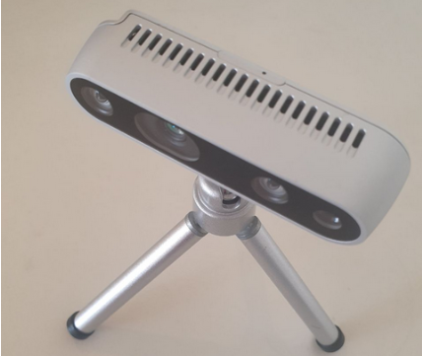
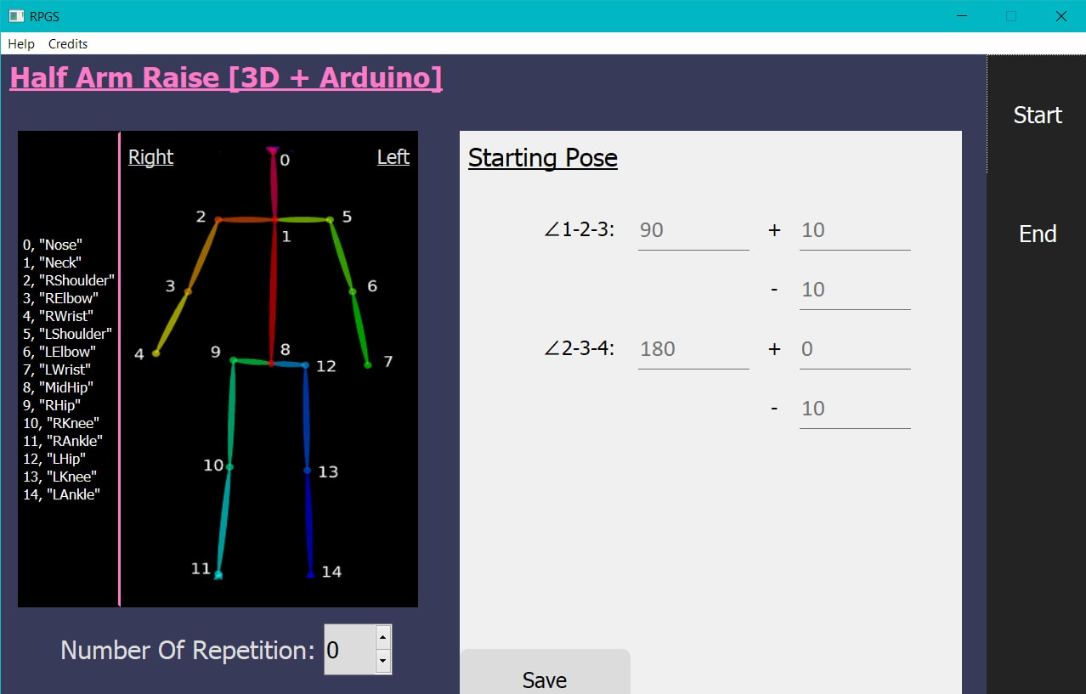
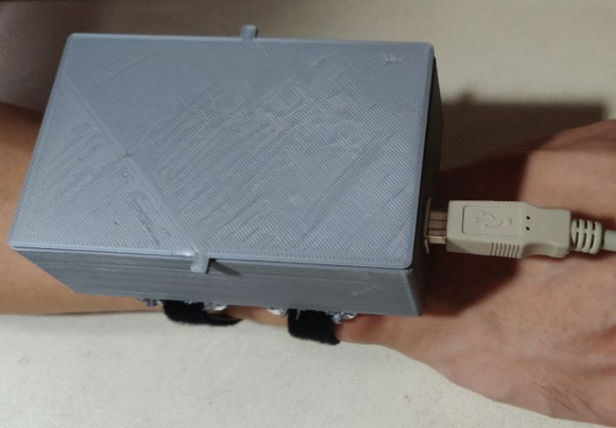
OUR PROJECT: RPGS
1. Intel RealSense D435 3D Camera
3. User-friendly dual-mode interface that allows for customisation of exercise difficulty
2. Wearable module containing accelerometer

Slide 6
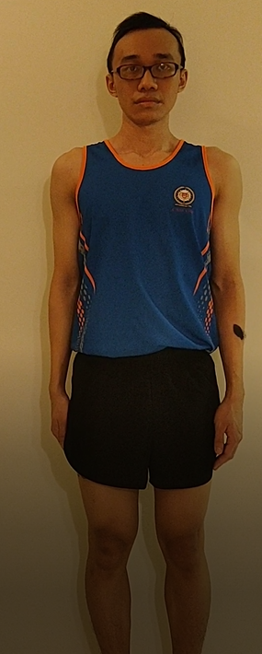
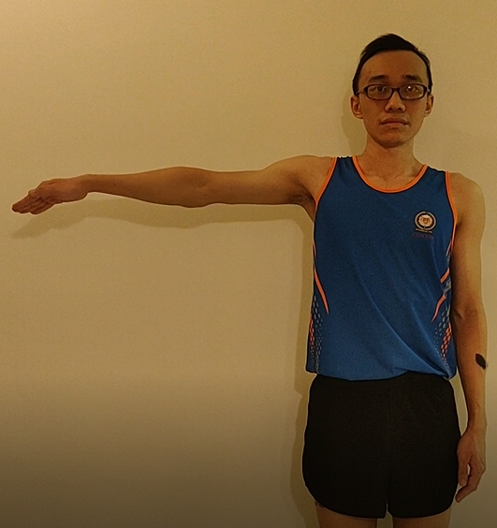
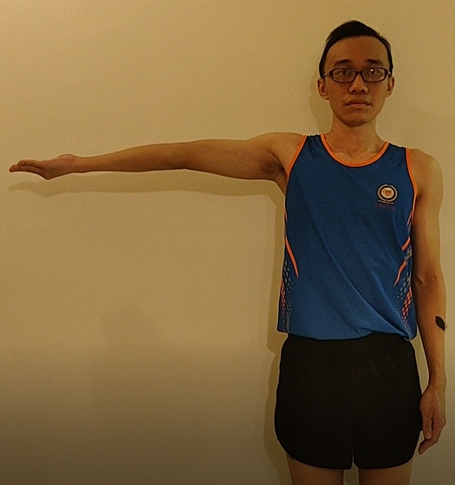
PROOF OF CONCEPT: SINGLE ARM RAISE AND ROTATION
Palms by side,
Fingers pointing
downward
2. Raise right arm 90º, palms facing floor
3. Rotate wrist 180º until palms facing ceiling
4. Palms by side,
Fingers pointing
downward
1 REP complete

Slide 7
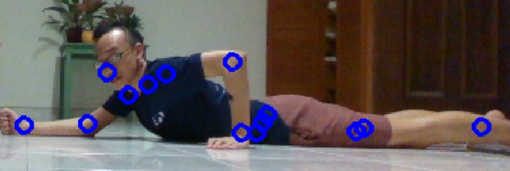
OPENPOSE DETECTION OF JOINTS
Openpose was used to detect skeletal joints:
- Stored as 2D pixel coordinates
Image source:https://github.com/CMU-Perceptual-Computing-Lab/openpose/blob/master/doc/output.md#pose-output-format-body_25
Notes:
Talking about the technical aspects of the project – how we achieved posture detection
OpenPose: Real-time multi-person keypoint detection library for body, face, hands, and foot estimation using Machine Learning (github software)
Keypoints are basically joints on the human body
Openpose only detects points on the screen as a 2D plane

Slide 8
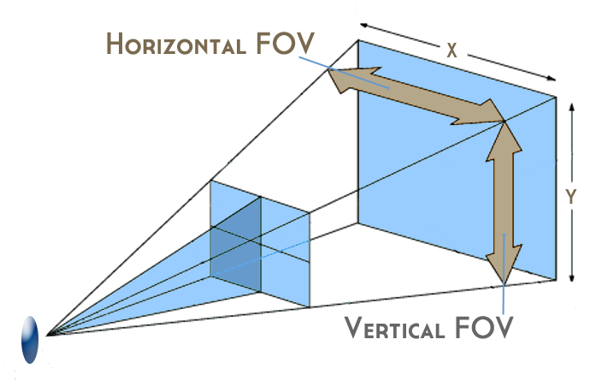
Data extraction from 3d camera
3D camera calculates depth of each keypoint
Deprojection converts keypoint coordinates into Cartesian basis representation
Relationships between keypoints used to detect error
Notes:
From the 2D keypoint arrays, the 3D camera is activated to calculate the depth (in meters) of each keypoint in real time. This is done by extracting the depth of pixels that correspond to each keypoint
There is a mismatch between the depth coordinate and the 2D keypoint arrays: 1 is in meters, the other 2 are in pixels – difficulty comes in here
Need to convert the pixels to meters – the width of each pixel is dependent on the depth of the keypoint detected – refer to diagram
Origin needs to be centered at the centre of the screen – initially at the top left hand corner
All this was achieved by deprojection

Slide 9
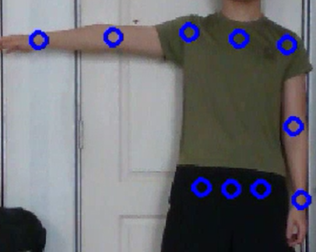
Intermediate checkpoints (CAMERA)
ANGLE 814 = 90^{O}
ANGLE 234 = 180^{O}
VECTOR 13 & VECTOR 14 90^{O} to plane defined by joints (1,9,12)
4
3
2
1
Relevant
Keypoints
9
8
12
Notes:
After storing the coordinates – analysis can be done with the relationships between the vectors with some simple coordinate geometry and vector concepts – helps to detect error next slide
Revise the single arm raise and rotation demo

Slide 10
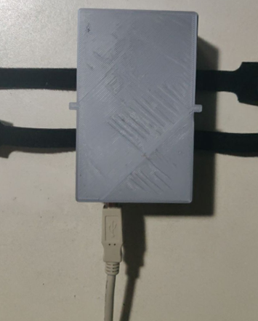
INTERMEDIATE CHECKPOINTS (accelerometer)
Used to detect the orientation of the module
For steps 1, 2, 3, 4: predominant directions are y, -x, x, y
y
z
x
Notes:
Wearable module contains an accelerometer connected to an Arduino, data transferred to Arduino IDE where it is read by pyserial and processed by the code

Slide 11
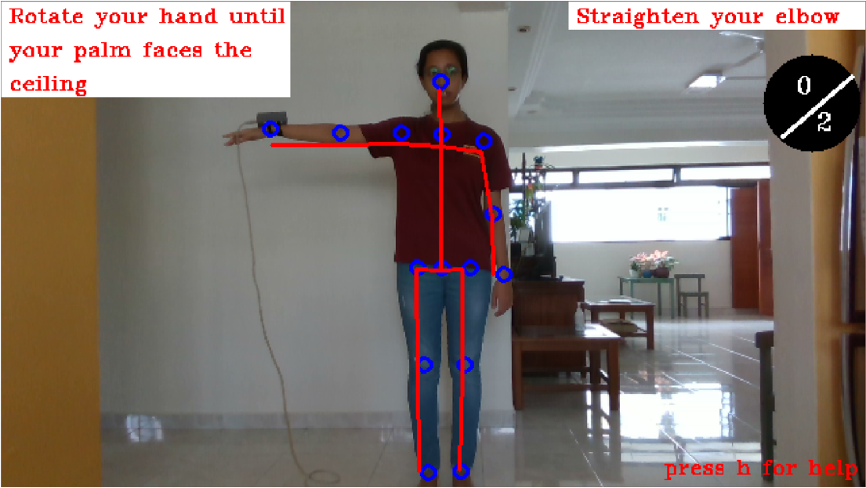
Interface operation
Notes:
Guidance skeleton in red, keypoints in blue
Instructions to correct pose on top
H for help
Rep count

Slide 12
Live demonstration time!

Slide 13
Spec sheet and instructions
Specification sheet
https://drive.google.com/file/d/1vd2XjbBBibtGOMTNgM-ZWKk_ha0r41bp/view?usp=sharing
Instructions manual
https://drive.google.com/file/d/1BveYebozMP-S6hQ4WsmtcubkFvw9bSnK/view?usp=sharing

Slide 14

Future works
Improve FPS
Dynamic monitoring
Human action recognition/classification

Slide 15
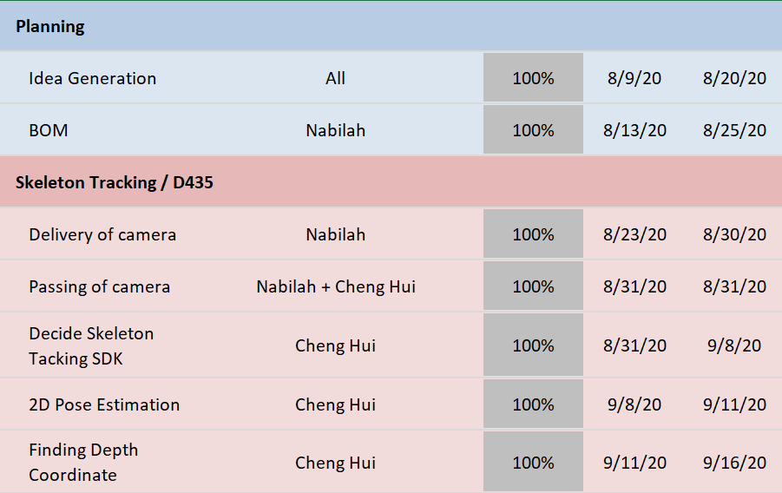
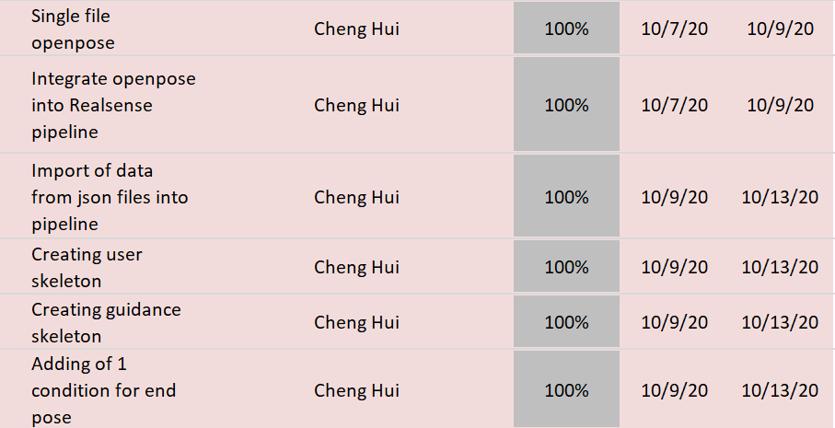
GANTT CHART

Slide 16
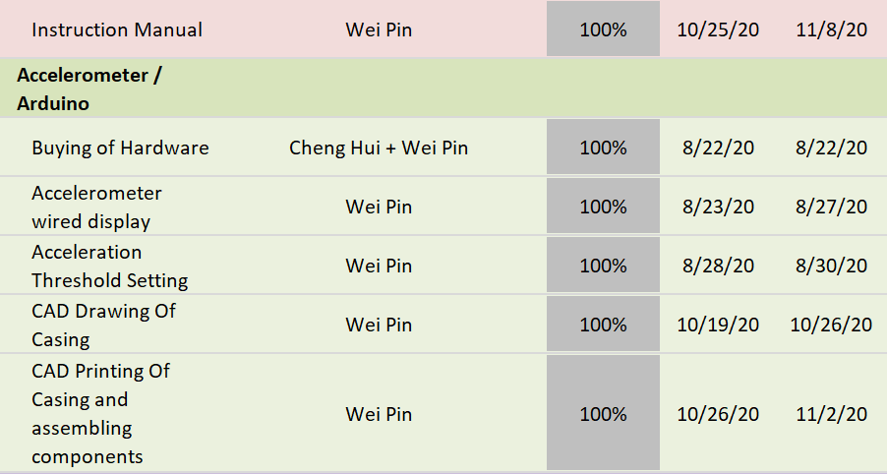
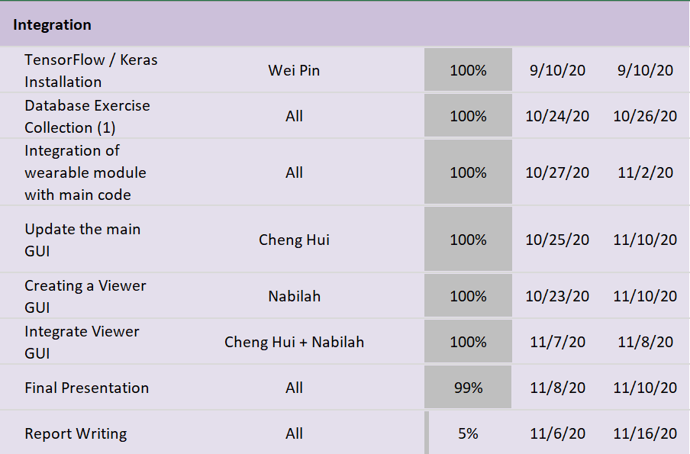
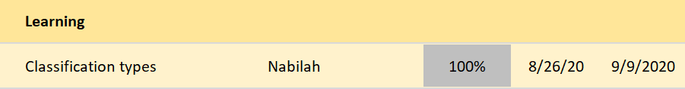
Gantt chart

Slide 17
References
Who.int (2018). at https://www.who.int/disabilities/care/Need-to-scale-up-rehab-July2018.pdf?ua=1
https://www.youtube.com/watch?v=O18JUKk0kak&t=25s
https://robotology.github.io/assistive-rehab/doc/mkdocs/site/

Slide 18
The end questions time

